Slide 1
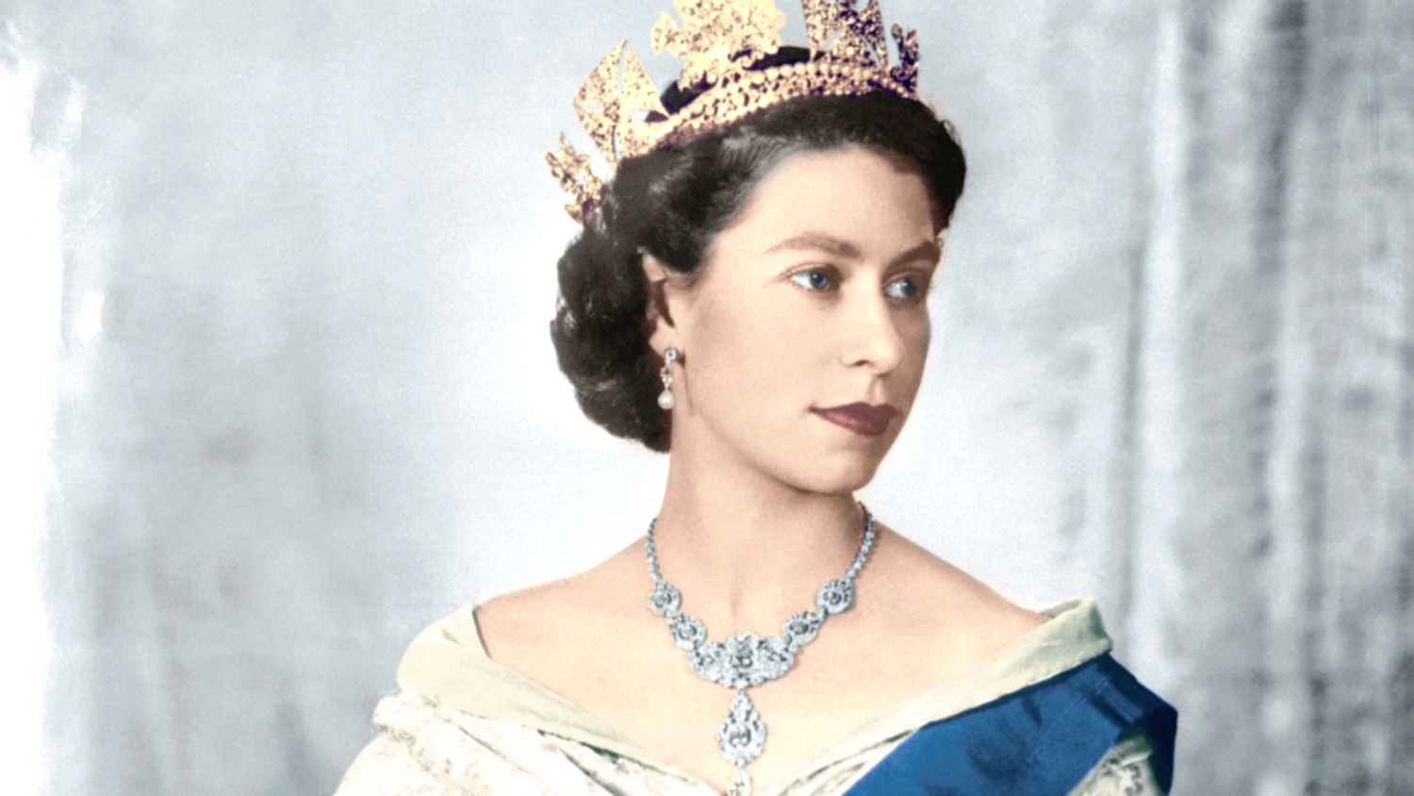

Slide 2
To Queen Elizabeth II
We all love you and always will.
We miss you already and you will forever be in our hearts.
Ava

Slide 3
Unfortunately upon the Queens passing I am sure many people will be upset about the news but hopefully we can move on and King Charles can step up to the role for many years to come. One of the thing I admire of about the Queen is the amount of effort she put in her role.

Slide 4
To my wonderful Queen,
You will forever be in our hearts. May you rest in peace.
Brooke

Slide 5
Dear Queen Elizabeth,
you were a great Monarch and you truly ran the country well, 96 was a great age to live to.
Jacob

Slide 6
To Her Majesty the Queen.
She never disappoints us.
Thank you
Naomi

Slide 7
Rest in peace, you were a good person.
Ariana

Slide 8
I am very sorry for your loss, Queen Elizabeth was a great leader.
Olivia

Slide 9
You always stayed strong during the hard times and I am really grateful.
Rayyan

Slide 10
Everyone will miss you.
Rhys

Slide 11
To the Royal family,
I am so sorry for your loss.
From Ethan Kai

Slide 12
To the Royal family, I am very saddened by your loss but we must keep our heads up high as we enter into a new era with King Charles III as our new King.
Rest in Peace Queen Elizabeth.
Rayan

Slide 13
I am really sorry that the Queen has died.
Rest in Peace
Teegan

Slide 14
During times like this it is very sad for everyone.
Rest in Peace Queen Elizabeth
Ben

Slide 15
In these sad times where we are mourning the sad loss of our Queen, we must remember in these dark, scary times to be happy and celebrate our new King.
Luke

Slide 16
We are so sorry for your loss, she was my favourite Monarch who will be missed.
Lucas

Slide 17
She never gave up even in the hardest situations. She was a big part of everyone's life.
Gabriella

Slide 18
To Her Majesty, you never gave up, you were always honest, you will always be there in our hearts.
Thank you
Elizah

Slide 19
To the Royal family, I am so sorry for your loss.​
​
From Ethan Kai

Slide 20
We wish the Queen was still with us, she did such a lot of our country.
Thank you
Logan

Slide 21
Rest in Peace to the Queen, we will miss you in our hearts.
Harvey

Slide 22
To the Royal Family, it is very sad now the Queen has died.
Rest in Peace
Lexi

Slide 23
Dear Royal Family
I am sorry for your loss she was the best Queen.
Alfie

Slide 24
I feel sad, the Queen has done so much for us and I feel like we should have done so much more for her.
Rest in Peace
Jack

Slide 25
I am very sorry for your loss and it will never feel the same without you.
You will be missed.
Imogen

Slide 26
I am very sorry for your loss, of our Majesty Queen Elizabeth II.
I hope you will all feel better soon.
Jack

Slide 27
During these dark times the Royal Family never gave up, I am very sorry for your loss of Queen Elizabeth II you will always be in our hearts.
Henry

